Slide 1

C++ Training

Slide 2

The plan
Day 1:
Reference semantics
Strong types
Value semantics
Day 2
Day 1 cont.
Containers, complexity and algorithms

Slide 3
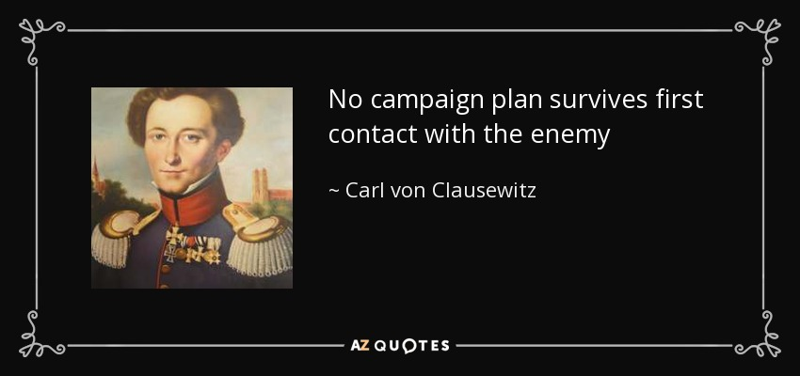

Slide 4
https://github.com/williamnagels/cpptraining.git
exercises/compilertest . Build using cmake, instructions by mail.
Expected to compile, link and print “Hello World!” .

Slide 5
Excercises
cpptraining/exercises mkdir build; cd build; cmake ..; make
Refers to symbols
ex1.o
main.o
test executable per module
ex2.o
includes
global.h
ex3.o

Slide 6
#include <iostream>
#include <map>
int main(){
auto f = [](auto& v){v=“ice barrier”;};
std::map<int, std::string> m = {{1, “combust”},{2, “blink”}};
for (auto& [k, v]:m){
f(v);
}
std::cout<< m[2]<<std::endl;
}

Slide 7
Source of your technology

